Slide 1

EE 252
Electrical Engineering Machines
UNIT 1 – Principles of Electromechanical Energy Conversion
Dr. E.K. Anto
kwakuantoh@yahoo.com//0208201565; 0243225858

Slide 2
Unit 0 – Course content
Principles of Electromechanical Energy Conversion.
Basic Transducers.
Single and Double Excitation.
DC Machines.
Introduction to Poly-phase Induction Machines.
Transformers.

Slide 3
Unit 1 – Outline of Presentation
Energy balance equation
Forces of alignment and their applications (transducers, attracted-armature relays, electromagnetic relay)
Forces of attraction and their applications in rotary machines
Rotating machines (types, constructional features)

Slide 4
1.1: Introduction
An electromechanical machine is one that links an electrical energy system to a mechanical system by providing a reversible means of energy flow in its magnetic field.
It is guided by the so-called energy equation
Energy input = Energy lost + Increase in stored energy + Energy Output
An electromechanical machine can be operated by either an alternating current or direct current, and can function as a motor, a generator or a converter under steady-state or transient conditions.
The function of a motor is to transfer electrical energy into mechanical energy
Whilst a generator converts mechanical energy into electrical energy.

Slide 5
1.1: Introduction (2)
Mechanical force or torque is associated with two displacements:
(1) linear (translational) or
(2) radial (rotary) displacement of its point of action.
Suppose an infinitesimal electrical energy input produces an infinitesimal increment in mechanical displacement.
The corresponding increments of mechanical energy output, loss, storage and output are related by the energy balance equation:
The mechanical power output accounts for both mechanical storages as well as the useful power.
The force exerted by the mechanical member in the direction of displacement is the rate of change of energy with position and is given by:

Slide 6
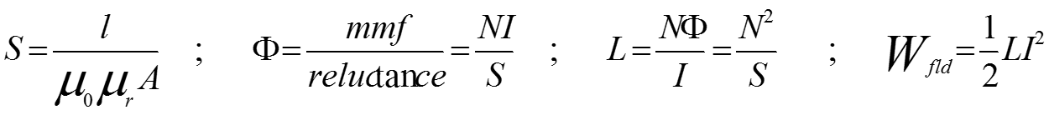
1.1: Introduction (3) – Useful magnetic equations
mmf = magnetomotive force l = length of magnetic path / airgap
S = reluctance L = inductance
B = flux density Wfld = field stored energy
H = magnetizing force μr = relative permeability
I = current μ0 = permeability due to free space
N= number of turns μ = permeability of magnetic material
A = cross-sectional area Φ = flux

Slide 7
1.2: Force of alignment and its application in basic transducers
An electromechanical system can develop a mechanical force in two ways:
By alignment
By interaction

Slide 8
1.2.1: Force of Alignment
The alignment force may be seen (i) either as a force of attraction or (ii) as a lateral force
The force of alignment acts in a direction that increases the magnetic stored energy in the arrangement

Slide 9
1.2.1: Force of Alignment (2)
In (a) it will try to bring the poles together, thus reducing the air-gap length.
This causes a decrease in the reluctance of the air gap in the magnetic circuit and
Hence will increase the flux and consequently the stored magnetic field energy
In (b), the poles are not situated opposite one another, and the resultant force tries to achieve maximum stored magnetic energy by two component actions:
By attraction of the poles towards one another as before
By aligning the poles laterally.

Slide 10

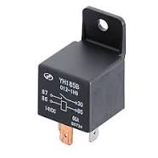
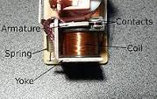

1.2.1.1: Basic transducer – Attracted armature relay
Transducers are (i) electromechanical machines that (ii) operate at very low power levels, and (iii) are used particularly to provide 'signals' with which (iv) to activate electronic control devices.
A microphone is a transducer that converts acoustic energy into electrical impulses.
Attracted-armature electromagnetic relay is a translational transducer where motion is linear

Slide 11
1.2.1.2: Attracted-armature relay – Principles of operation
The armature-attracted relay is an example of the so-called singly-excited electromechanical machine.
Principles of operation
When the coil is energized by an instantaneous voltage e such that a current flows, a flux is set up in the relay core and the air gap.
The surfaces adjacent to the air gap become magnetized and are attracted, hence pulling the plate in the direction shown.
It must be noted that it is this change in magnetic field energy that produces the force of reaction over the distance dx.
It can be noted that the velocity is
Recall the energy equation

Slide 12
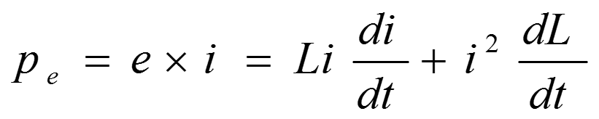
1.2.1.3: Alignment force on attracted-armature relay
Electrical Power Input :
The electrical power input is given as the product of the instantaneous voltage and current.
Thus
But
Thus

Slide 13
1.2.1.3: Alignment force on attracted-armature relay (2)
Losses:
The change takes place relatively slowly over a short distance, the losses may be assumed negligible.
Thus = 0
Field Stored Energy Field:
It is given as

Slide 14

1.2.1.3: Alignment force on attracted-armature relay (3)
Mechanical Power :
From the energy equation, the mechanical power is given as:
But the mechanical power is also given as the product of force and velocity. Thus

Slide 15
1.2.1.3: Alignment force on attracted-armature relay (4)
Combining the two equations, we obtain
Since some of the stored energy is retained in the air gap and all of the energy is stored within the magnetic circuit, this force is alternatively referred to as the reluctance force.
It is sometimes convenient and useful to express the force in terms of the rate of change of reluctance with the air gap length.

Slide 16
1.2.1.3: Alignment force on attracted-armature relay (5)
Consider the general expression of the force in terms of rate of change of inductance with air gap length.

Slide 17
1.2.1.4: Alignment force between parallel magnetic surfaces
Force of Alignment between Parallel Magnetized Surfaces:
The reluctance is given as:
Where for air, and is the particular value for the arrangement

Slide 18
1.2.1.4: Alignment force between parallel magnetic surfaces (2)
Force equation:
Differentiating the reluctance with respect to the distance, we obtain:
Thus, the force equation can be re-written as

Slide 19
1.2.1.5: Example 1
An electromagnet shown below has a core of effective length 600 mm and a cross-sectional area of 500 mm2. A rectangular block of steel of mass 2 kg is attracted by the electromagnet's force of alignment when its 250-turn coils are energized. The magnetic circuit is 200 mm long and the effective cross-sectional area is also 500 mm2. If the relative permeability of both core and steel block is 700, estimate the coil current. Neglect frictional losses and assume the acceleration due to gravity as g=10 m/s2.

Slide 20
1.2.1.5: Solution 1
There are two air gaps in the magnetic circuit.
Hence the force to part the steel block is double that for a single air gap.
The flux density is thus given by
The magnetizing force is

Slide 21
1.2.1.5: Solution 1(2)
The magnetomotive force is given by
Hence the current is given as:

Slide 22
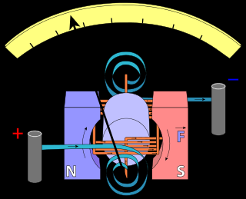
1.2.2: Force of Interaction – Its Application in Rotary Machines
Force of Interaction on a Current-Carrying Conductor:
Consider a rectangular coil of N turns of dimensions in which the plane of the coil is at an angle to the direction of a uniform magnetic field of density B.
The coil is pivoted about the midpoints of the sides and carries a current.

Slide 23
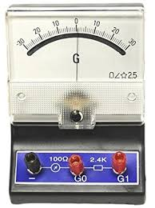
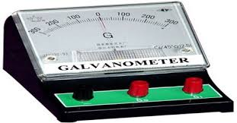
1.2.2: Force of Interaction – Its Application in Rotary Machines (2) Galvanometer
The flux density is given by the flux passing uniformly and normally, i.e. at right angles through the surface area .
Since the plane is not at right angles to the direction of the field but inclined at an angle, the flux through the plane is given by:
The force exerted on the N turns is given by the expression:
The torque on the coils is given by:

Slide 24
1.3: Rotating Machines – Types and Constructional Features
The linear operations of machines have a drawback that the motion such linear machines give rise to, is not continuous.
A rotating machine, which is an electromechanical energy conversion device, may be used either to convert mechanical energy to electric energy or to convert electric energy to mechanical energy.
When a machine is driven mechanically by a prime mover such as a steam turbine, hydraulic turbine or diesel engine, and delivers electric energy at its output, it is called a generator.
If electric energy is supplied to the machine and its output is used to drive mechanical devices such as conveyors or machine tools, it is called a motor.

Slide 25
1.3.1: Generator action – Fleming’s Right Hand Rule
The generator action depends on the principle that an emf is induced in a conductor cutting magnetic lines of flux.
This relation is summed up in Fleming’s Right-Hand-Rule which states that:
“Extend the thumb, the forefinger and the middle finger of the right hand at right angles to one another. Point the forefinger in the direction of the flux and the thumb in the direction in which the conductor is moving; then the middle finger will point in the direction of the induced emf”.
Generators are rated as to the kilowatts (or megawatts) they can deliver without overheating at a rated voltage and speed.

Slide 26
1.3.2: Motor action – Fleming’s Left Hand Rule
The motor action is based on the principle that when a current-carrying conductor of active length L is placed in a magnetic field of field strength B, it experiences a mechanical force F.
The direction of the force is given by Fleming’s Left-Hand Rule
The magnitude of the force is given by the relation
The Fleming’s Left-Hand Rule may be stated as follows:
“Extend the thumb, the forefinger and the middle finger of the left hand at right angles to one another. Now turn the left hand in such a position that the forefinger points in the direction of the field and the middle finger in the direction of the current in the conductor; then the thumb will point in the direction of force or motion of the conductor”.
Motors are rated as to the horsepower (or kilowatts) they can deliver without overheating at their rated voltage and speed.

Slide 27
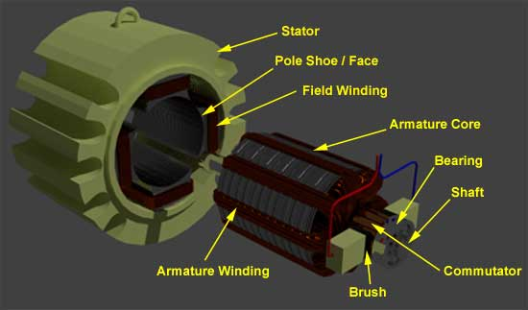
1.4: Constructional Features of Rotating Machines
Rotating electrical machines have the following essential constructional parts:
(1) Stator (stationary member)
(2) Rotor (rotating member)
(3) Auxiliary equipment such as
slip rings (or collector rings)
Brush-gear/commutator assembly
(carbon brushes, split-rings, etc.) for DC
armature shaft bearings
starting circuit (for single-phase AC motors)

Slide 28
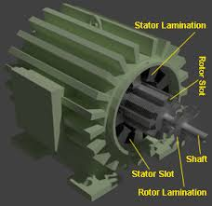
1.4.1: Stator Unit
The stator unit is the stationary part of the machine and consists of the stator frame or yoke, pole-shoes and pole coils (or stator field coils).
(a)Stator and one of its coils (b) Salient-Pole Stator

Slide 29
1.4.1: Stator Unit (2)
The stator frame or yoke serves the purposes of
(1) Providing mechanical support for the poles
(2) Protection for the machine and
(3) Carrying the magnetic field or flux produced by the poles.
The stator yoke carries the stator pole-cores and pole-shoes, which serve a double purpose of:
(i) spreading out the flux in the air gap, and being of larger cross-sectional area, reducing the reluctance of the magnetic path
(ii) supporting the field coils (or exciting coils).
Pole-cores and pole-shoes are made of cast iron or cast steel, forged steel or steel laminations to reduce hysteresis and eddy-current loss

Slide 30
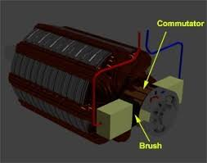
1.4.2: Rotor Unit
The rotor, which is the rotating part of the machine.
The rotor core is usually cylindrical or drum-shaped, and is built of steel laminations with slots to house the rotor windings
The rotor windings (also referred to as armature) are insulated from each other and placed in rotor slots which are lined with tough insulating material.

Slide 31
1.4.3: Auxiliary Equipment
The Commutator:
The commutator or split-rings is made of copper segments.
Its purpose is to facilitate the collection of current from the armature windings.
The Brushgear:
To collect current from a rotating commutator or to feed current to it, use is made of brushgear;
It consists of brushes, brush holders, brush studs or brush-holder arms, current-collecting busbars, etc.
The Armature Shaft Bearings:
Because of their reliability, ball-bearings are frequently employed, though for heavy duties, roller-bearings are preferable.
The ball and rollers are lubricated by hard oil for quieter operation and for reducing the wear of the bearings.

Slide 32
1.5: Exercises
(1) What is a basic transducer?
(2) By means of a diagram, briefly explain the principle of operation of an attracted-armature electromagnetic relay.
(3) A solenoid relay operating from a 240 V DC supply has a 4500-turn coil of resistance 8.5 kΩ. The core diameter of the relay is 30 mm and the airgap length is 1.5 mm, the armature being stationary. Assuming the gap surfaces to be parallel and taking , determine the following:
(i) gap flux density
(ii) inductance of the coil
(iii) force exerted on the armature
(4) State THREE (3) functions of the stator frame or yoke of a DC machine.
5) Explain why the rotor and stator of the DC machines are laminated.

Slide 33
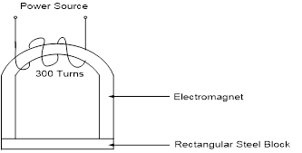
1.5: Exercises (2)
(6) An electromagnet shown below has a core of effective length 610 mm and a cross-sectional area of 520 mm2. A rectangular block of steel of mass 2.5 kg is attracted by the electromagnet’s force of alignment when its 300-turn coils are energized. The magnetic circuit is 220 mm long and the effective cross-sectional area is also 520 mm2. If the relative permeability of both core and steel block is 750, estimate the coil current. Neglect frictional losses and assume the acceleration due to gravity as .

Slide 34
1.5: Exercises (3)
(7) A U-shaped electromagnet having three (3) airgaps has a core of effective length 750 mm and a cross-sectional area of 650 mm2. A rectangular block of steel of mass 6.5 kg is attracted by the electromagnet’s force of alignment when its 500-turn coils are energized. The magnetic circuit is 250 mm long and the effective cross-sectional area is also 650 mm2. If the relative permeability of both core and steel block is 780, estimate the coil current. Neglect frictional losses and assume the acceleration due to gravity as .
[Hint: There are 3 airgaps, and so the force equation must be multiplied by 3]

Slide 35

Thank You – End of Unit 1
For any concerns, please contact
elearning@knust.edu.gh
elearningknust@gmail.com
0322 191132

